Slide 1
Automated Car Catalog System For Enhanced Showroom Management
SlideMake.com

Slide 2
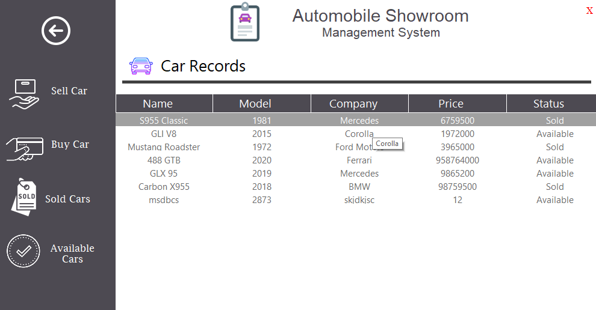
Introduction to Automated Car Catalog System
An automated car catalog system streamlines the management of vehicle inventories in showrooms.
It enhances the customer experience by providing quick and detailed vehicle information.
The system integrates modern technologies to optimize showroom operations and sales processes.
Notes:
Image source: https://user-images.githubusercontent.com

Slide 3

Objectives of the System
To improve efficiency in managing and updating vehicle data.
To facilitate better customer engagement through interactive and accessible catalogs.
To enable showroom staff to access real-time inventory information seamlessly.
Notes:
Image source: https://www.slidemake.com

Slide 4
Key Features and Components
Digital inventory management with detailed vehicle specifications and images.
Search and filtering options for customers to find preferred vehicles easily.
Integration with sales and CRM systems for comprehensive customer and vehicle data handling.
Notes:
Image source: https://www.slidemake.com

Slide 5
Benefits for Showroom Management
Reduced manual work and minimized errors in vehicle data entry.
Faster updating of vehicle information, including availability and pricing.
Improved decision-making with real-time data analytics and reporting capabilities.
Notes:
Image source: https://www.slidemake.com

Slide 6

Customer Experience Enhancement
Interactive digital catalogs that can be accessed via kiosks or mobile devices.
Customization options allowing customers to compare models and features effectively.
Increased engagement through multimedia content like videos and virtual tours.
Notes:
Image source: https://smartbridge.com

Slide 7
Implementation Technologies
Cloud-based databases for scalable and secure data storage.
Web-based interfaces for easy access across devices and locations.
Use of AI and machine learning for personalized recommendations and analytics.
Notes:
Image source: https://www.slidemake.com

Slide 8
Challenges and Solutions
Data security concerns addressed through encryption and secure access protocols.
Integration with existing systems requires careful planning and customization.
Training staff to adapt to new technologies with comprehensive onboarding programs.
Notes:
Image source: https://www.slidemake.com

Slide 9
Case Study / Example Scenario
A leading showroom implemented the system and saw a 30% increase in sales efficiency.
Customer satisfaction improved due to faster information retrieval and personalized options.
The system enabled better inventory control, reducing unsold stock.
Notes:
Image source: https://www.slidemake.com

Slide 10

Future Trends and Developments
Incorporation of augmented reality for virtual vehicle viewing experiences.
Use of IoT sensors to monitor vehicle conditions and update data automatically.
Expansion of AI-driven insights for predictive maintenance and customer preferences.
Notes:
Image source: https://skywell.software

Slide 11
Conclusion and Summary
An automated car catalog system significantly enhances showroom management and customer satisfaction.
It offers operational efficiencies, real-time data access, and innovative customer engagement tools.
Continued technological advancements will further transform the automotive retail experience.
Notes:
Image source: https://www.slidemake.com

